Slide 1



How to Revise Geography
Monday, 13 April 2026
Do Now |
1. On a MWB list how you revise geography.
2. On the other side of the MWB list the papers and topics. .
5 minutes

Slide 2

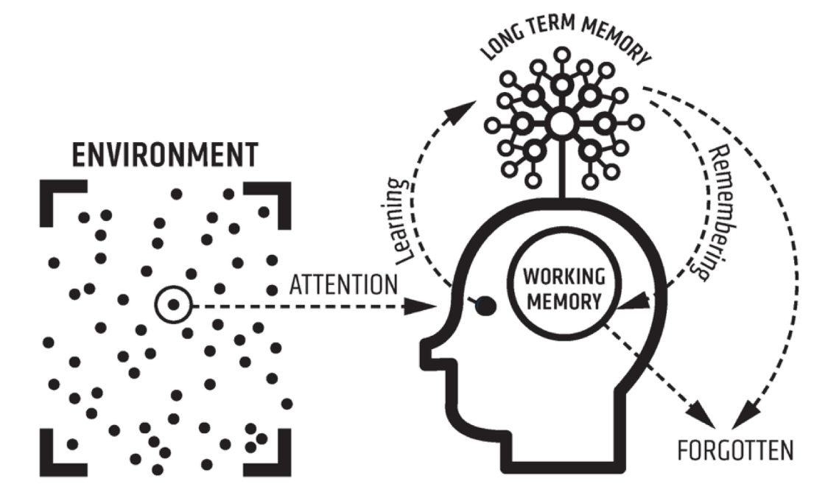
How to Revise Geography
Teach |

Slide 3

How to Revise Geography
Teach |

Slide 4
How to Revise Geography
Teach |
1. Revise by Paper (Not Random Topics)
📘 Paper 1: Living with the Physical Environment
Natural hazards (tectonic, weather, climate change)
Ecosystems (rainforests, deserts)
Physical landscapes (rivers, coasts)
📕 Paper 2: Challenges in the Human Environment
Urban issues & challenges
Economic world
Resource management (usually water)
📗 Paper 3: Geographical Applications
Issue evaluation
Fieldwork
UK map skills

Slide 5
How to Revise Geography
Teach |
2. Case Studies = Guaranteed Marks
AQA expects named examples.
Learn these for EVERY case study:
Location (country + region)
Key facts & statistics
Causes
Effects (social, economic, environmental)
Responses/management
📌 Tip: Put each case study on one A4 page.

Slide 6
How to Revise Geography
Teach |
3. Learn AQA Command Words
This is HUGE for GCSE marks.
Command word | What to do
Describe | What you see
Explain | Give reasons
Compare | Similarities + differences
Assess / Evaluate | Pros + cons + judgement
Suggest | Use your knowledge (no case study needed)

Slide 7
How to Revise Geography
Teach |
4. Practice the Big Mark Questions
AQA often uses:
6 markers and 9 markers
Structure for 6-mark “Explain”:
2 clear points KUU x 2
Each point explained
Use a case study if required
Structure for 9-mark “Evaluate”:
For argument AKUUA
Against argument AKUUA
Conclusion with judgement

Slide 8
How to Revise Geography
Teach |
5. Diagrams Win Marks
Practice drawing:
River long profile & cross profile
Coastal erosion & deposition
Tropical rainforest layers
You can get marks even with simple, labelled sketches.

Slide 9
How to Revise Geography
Teach |
6. Fieldwork (Paper 3)
Know:
Aim
Method
Data collection
Results
Conclusions
Improvements
Learn generic answers you can adapt to any fieldwork question.

Slide 10
How to Revise Geography
Teach |
7. Use AQA-Style Resources
Best revision tools:
AQA past papers + mark schemes
BBC Bitesize (AQA)
CGP revision guide
Seneca Learning (AQA)
👉 After answering a question, always check the mark scheme and examiner reports (for model answers and marks)

Slide 11
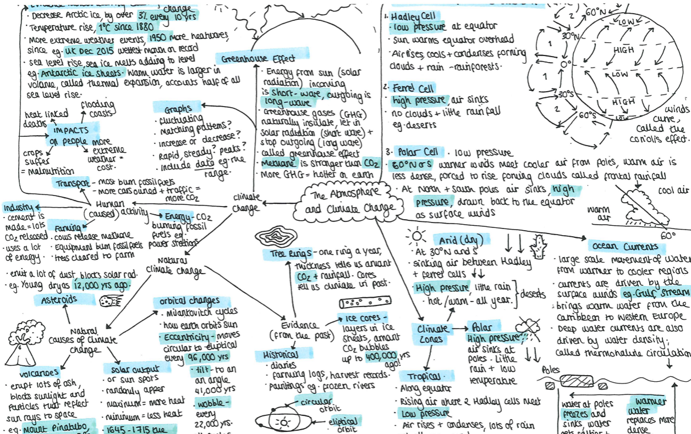
How to Revise Geography
Teach |
Mind Maps

Slide 12
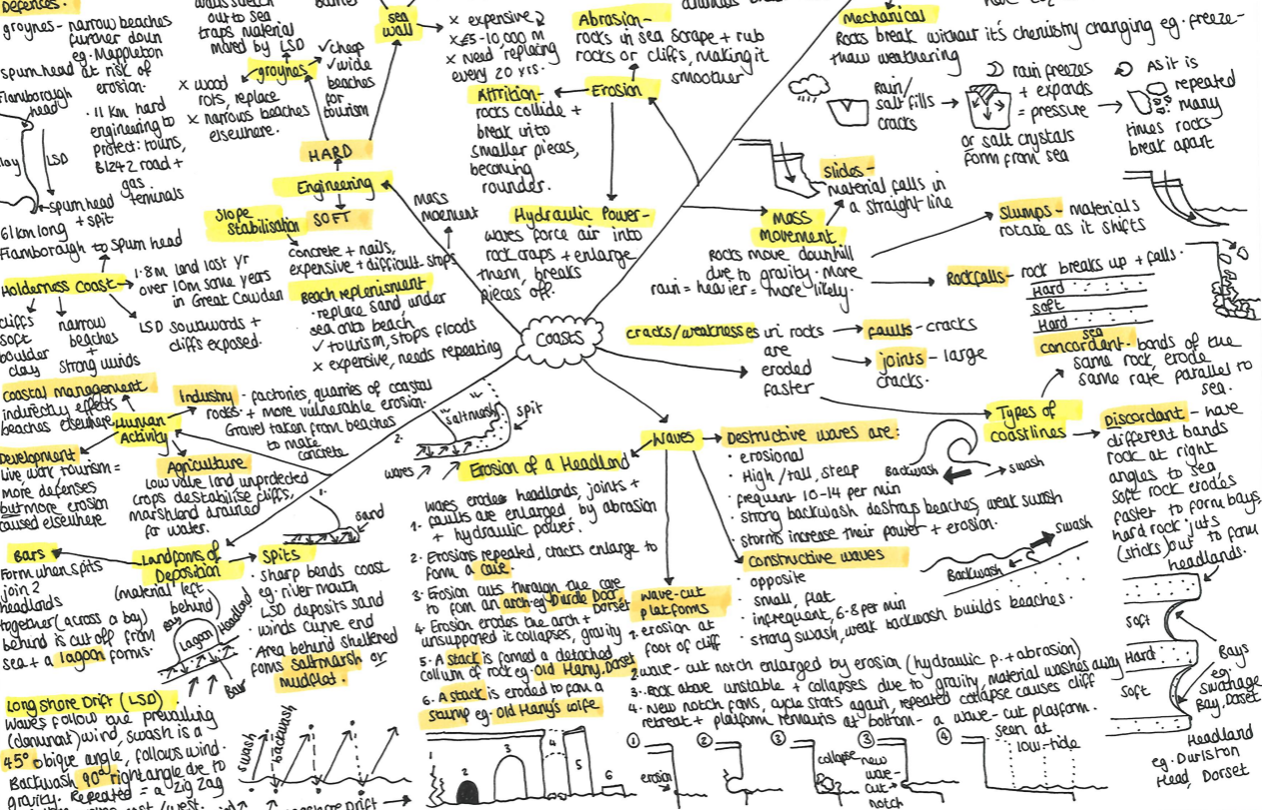
How to Revise Geography
Teach |
Mind Maps

Slide 13
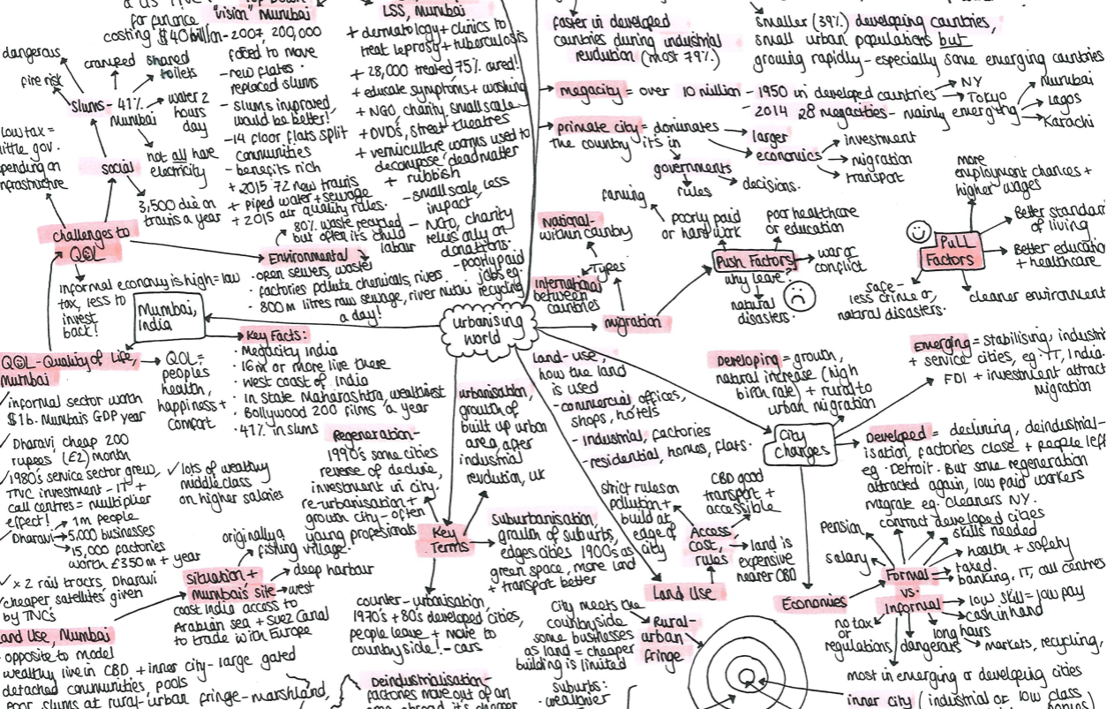
How to Revise Geography
Teach |
Mind Maps

Slide 14
How to Revise Geography
Teach |
Mind Maps
Choose one topic – put in the centre & circle
Clockwise (for right-handed), anti-clockwise for left – start mapping out the key sub-topics in thick lines called main branches. Best if one or a short sentence
Add key info – keywords, definitions, facts, statistics
Use colour coding & dual coding
Add diagrams & symbols = better memory
Link ideas e.g., urbanisation → housing shortage → squatter settlements (for chains of reasoning KUU)
Look, cover, write, check
Improve it, re-write it & condense it

Slide 15
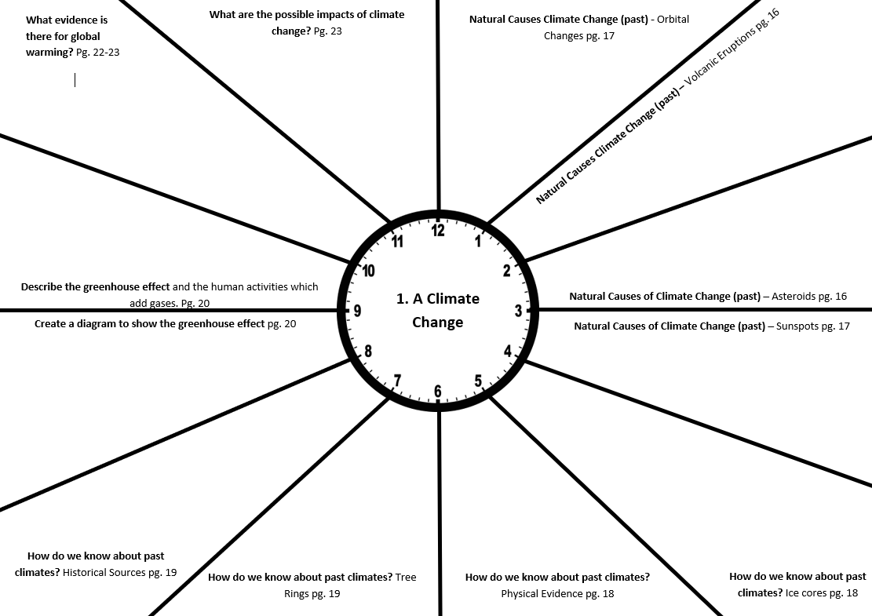
How to Revise Geography
Teach |
Revision Clocks

Slide 16
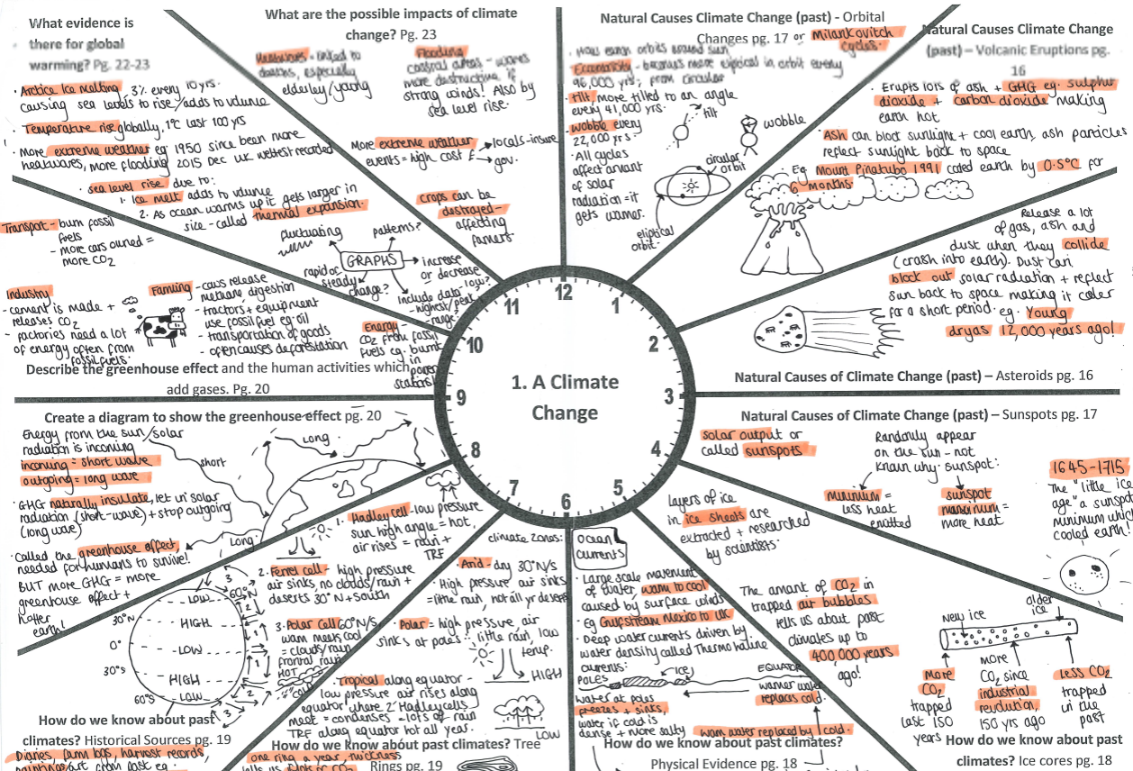
How to Revise Geography
Teach |
Revision Clocks

Slide 17
How to Revise Geography
Teach |
Revision Clocks
Draw the clock or use a template
The main topic is central, each section is a sub-topic
Fill each section from the revision guide
Use colour, dual coding & symbols
Then do the revision clock from memory
After, use a revision guide and a different colour pen e.g., green, to add in mistakes & missed areas – what you do not know yet
Use the clock to do exam practice, turn each section into a 6 mark explain question (KUU x 2)
Repeat from memory later on with no notes for long-term memory

Slide 18
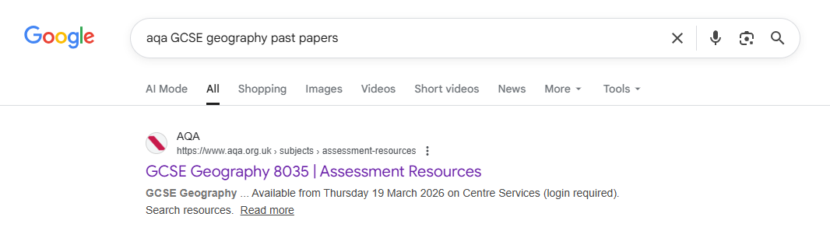
How to Revise Geography
Teach |
Exam Practice

Slide 19
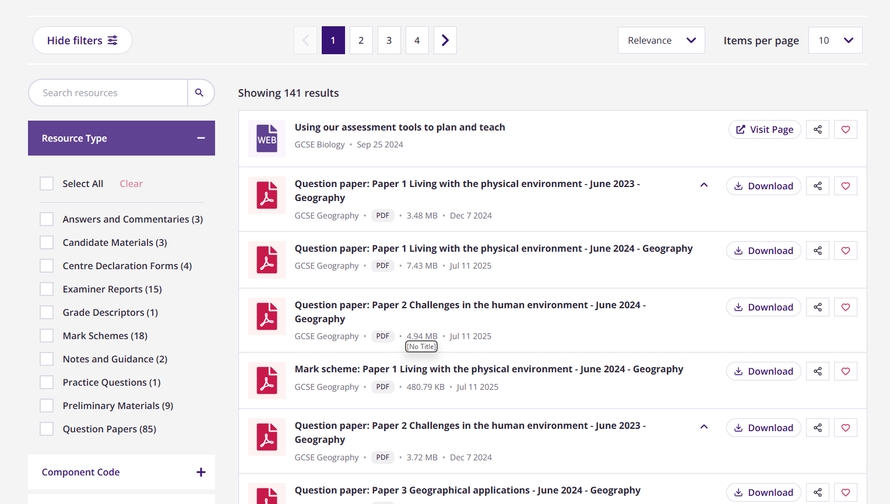
How to Revise Geography
Teach |
Exam Practice

Slide 20
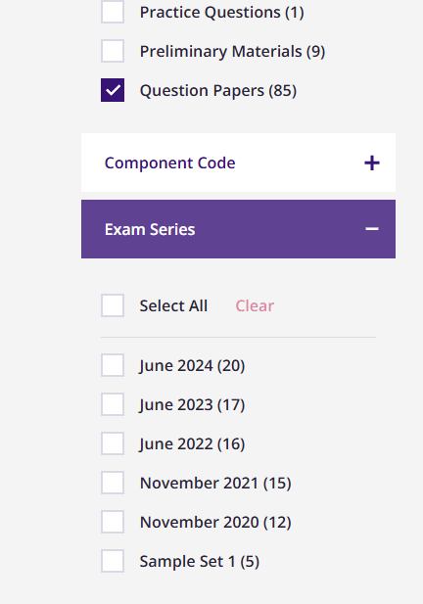
How to Revise Geography
Teach |
Exam Practice

Slide 21
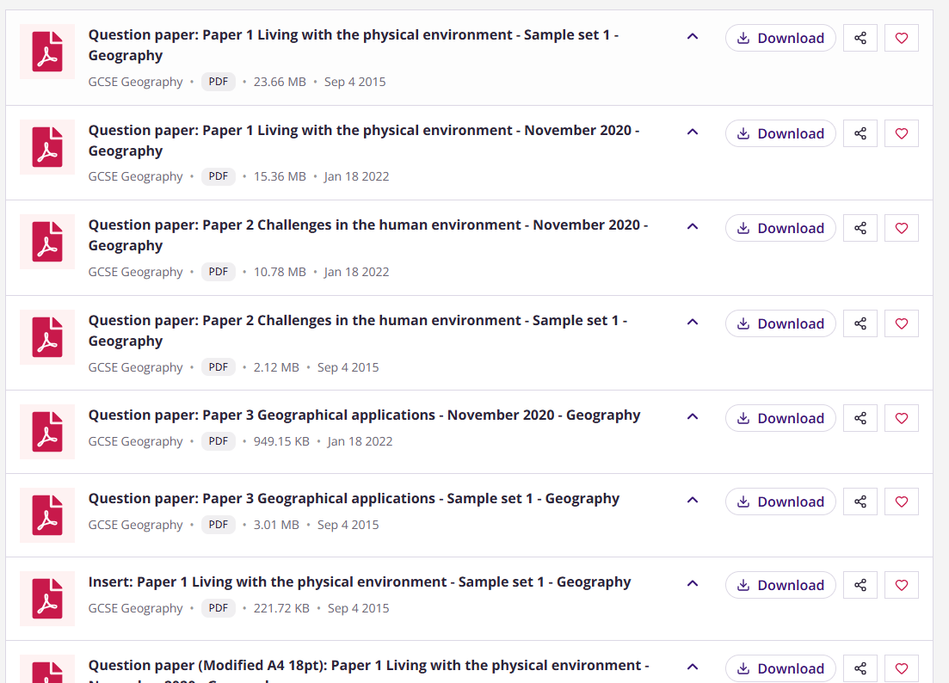
How to Revise Geography
Teach |
Exam Practice

Slide 22
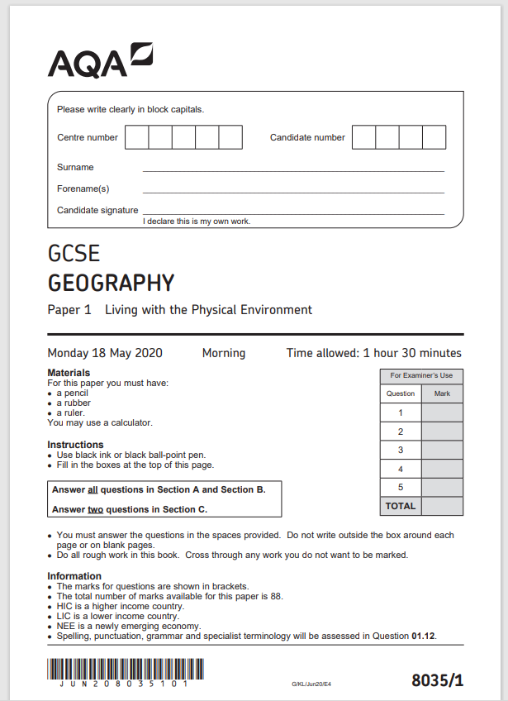
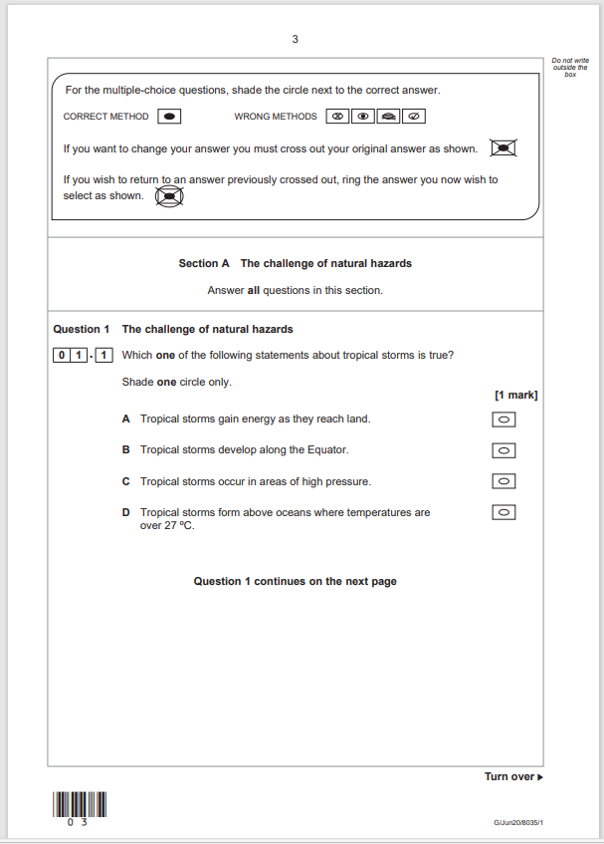
How to Revise Geography
Teach |
Exam Practice

Slide 23
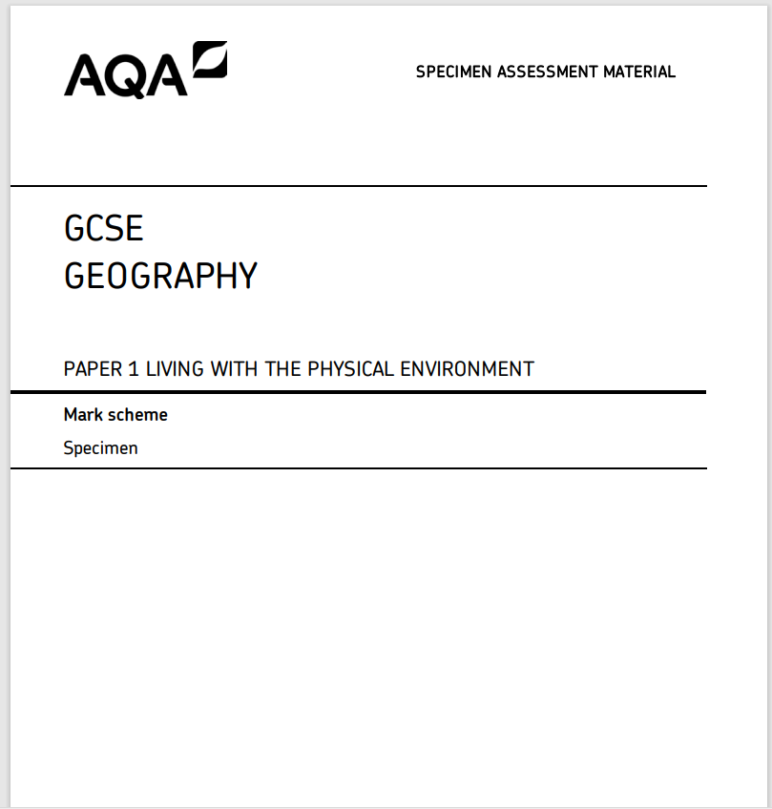
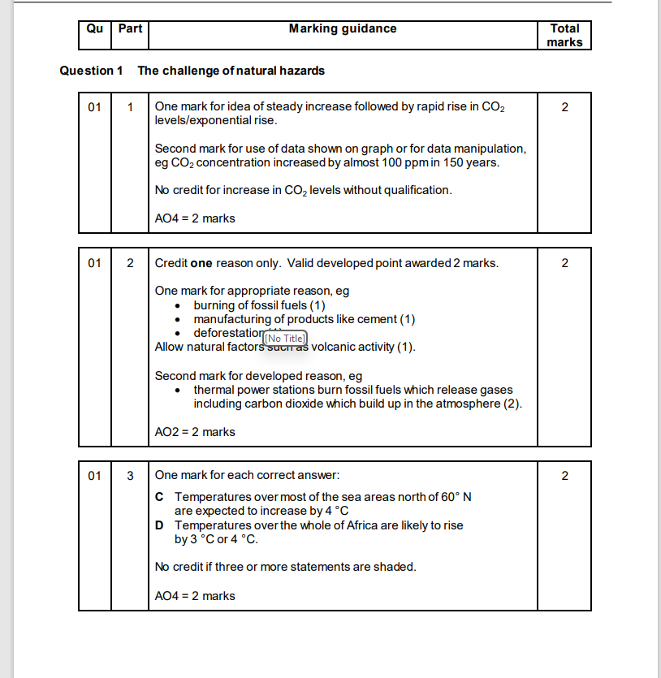
How to Revise Geography
Teach |
Exam Practice

Slide 24
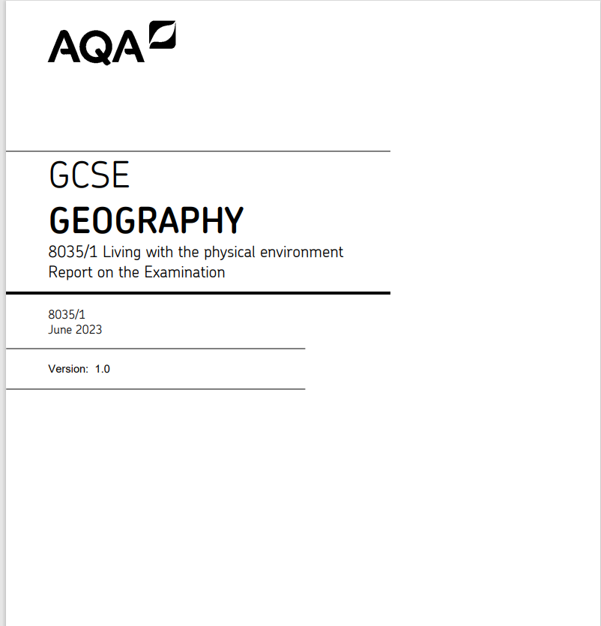
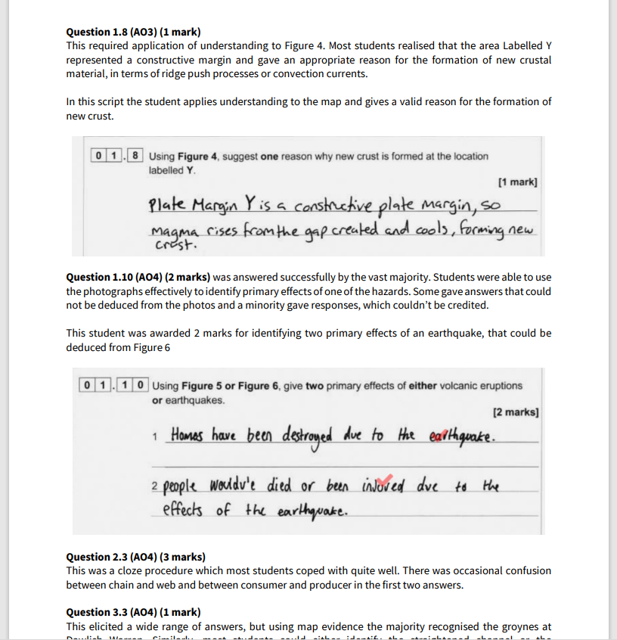
How to Revise Geography
Teach |
Exam Practice

Slide 25
How to Revise Geography
Teach |
Past Papers
Choose the correct exam board, print or answer on lined paper
Prepare like an exam – no phone, music, at a desk, timed
Read the questions carefully, BUG the 6/9 markers and answer fully
Stop when the time is up
Mark using the correct mark scheme in green pen, improve every answer
Correct all errors in green & use this to write one page of A4 which summarises your mistakes
Track your progress
TIP only do this after you have revised the content!!! ☺

Slide 26
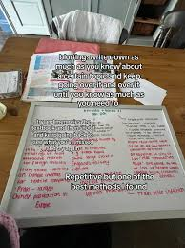
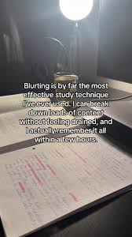
How to Revise Geography
Teach |
Blurting
Read a topic.
Close the book.
Write everything you remember on scrap paper or a whiteboard
Check and fill gaps in a different colour e.g., green pen
Go again!

Slide 27
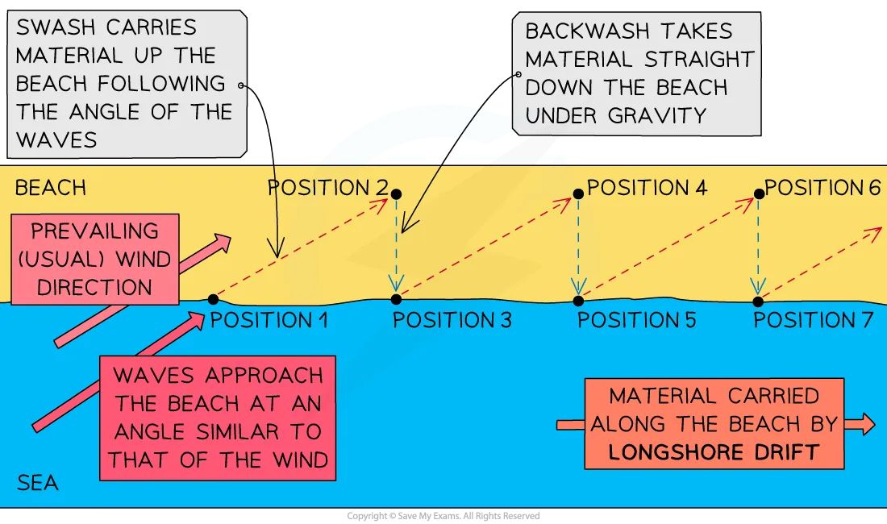

Slide 28
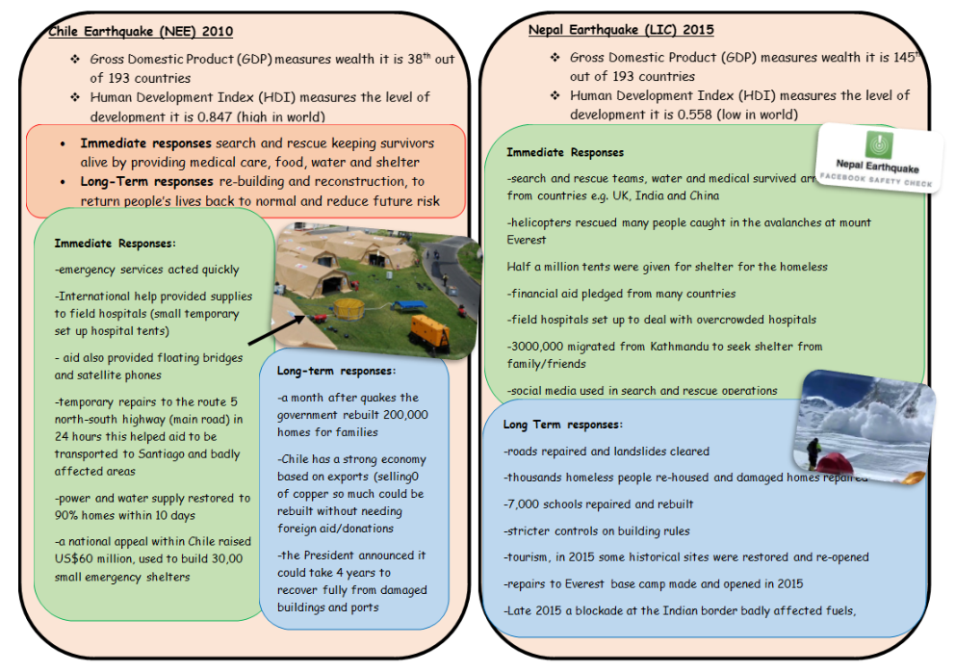
How to Revise Geography
Teach |
Flashcards
Definitions
Processes
Case study facts e.g., location, causes, impacts, responses, significance

Slide 29


How to Revise Geography
Teach |
Flashcards
Definitions
Processes
Case study facts e.g., location, causes, impacts, responses, significance

Slide 30
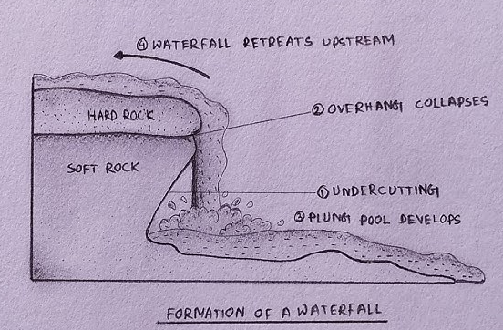
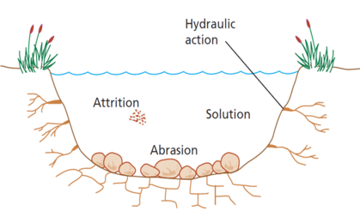
How to Revise Geography
Teach |
Diagrams
Geography is visual. Redraw diagrams (river cross-sections, coastal processes).
Label blank maps.
Sketch processes from memory (even messy drawings help recall).

Slide 31
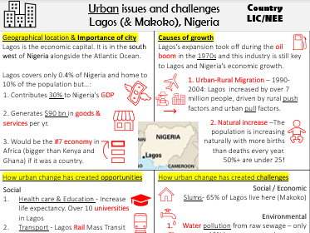
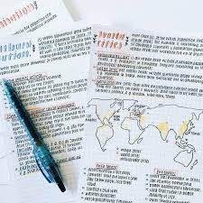
How to Revise Geography
Teach |
Case Studies
Examiners love specific detail.
For each case study, know: Where it is (country, region).
Key facts & statistics.
Causes, impacts, responses (for hazards).
Pros and cons (for development/management).
👉 Make one-page summaries for each case study.

